Slide 1
CS3205 – HCI in Software Development History Of HCI
Mark Floryan
Rice Hall 203
mrf8t@cs.virginia.edu

Slide 2
The (Very Brief) History Of HCI

Slide 3
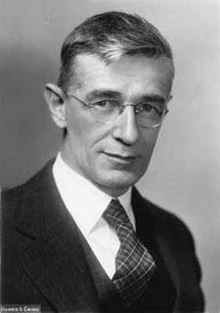
1945: Vannevar Bush
The Memex (Hypothetical)
“…an electromechanical device enabling individuals to develop and read a large self-contained research library, create and follow associative trails of links and personal annotations, and recall these trails at any time to share them with other researchers. This device would closely mimic the associative processes of the human mind, but it would be gifted with permanent recollection.”
First concept of hypertext system. Led to the development of html and the WWW (some say).

Slide 4
1930’s: Vannevar Bush

Slide 5
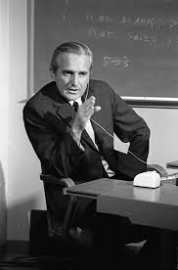
1968 – Douglas Engelbart
NLS or “oN-Line System”
First GUI
Mouse
Hypertext Links
Raster-scan video monitors
Screen Windowing
Keyboard shortcuts
Engelbart is widely seen as the father of HCI
1970: Palo Alto Research Center (PARC) created by Xerox
Goal: First commercial GUI
Many of Engelbart’s researchers become alienated and leave to join Xerox.

Slide 6
The Mother of All Demos (1968)
Kind of a weird title, but hey!
http://www.youtube.com/watch?v=yJDv-zdhzMY

Slide 7
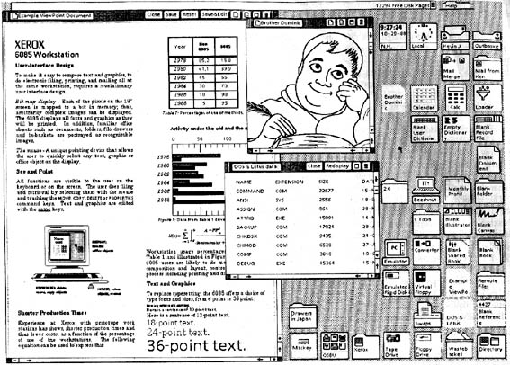
Xerox ALTO (1973)

Slide 8
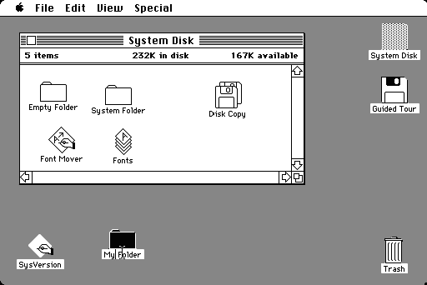
1984 - Macintosh
Small but enthusiastic constituency.
Today, more of a bandwagon thing going on.

Slide 9
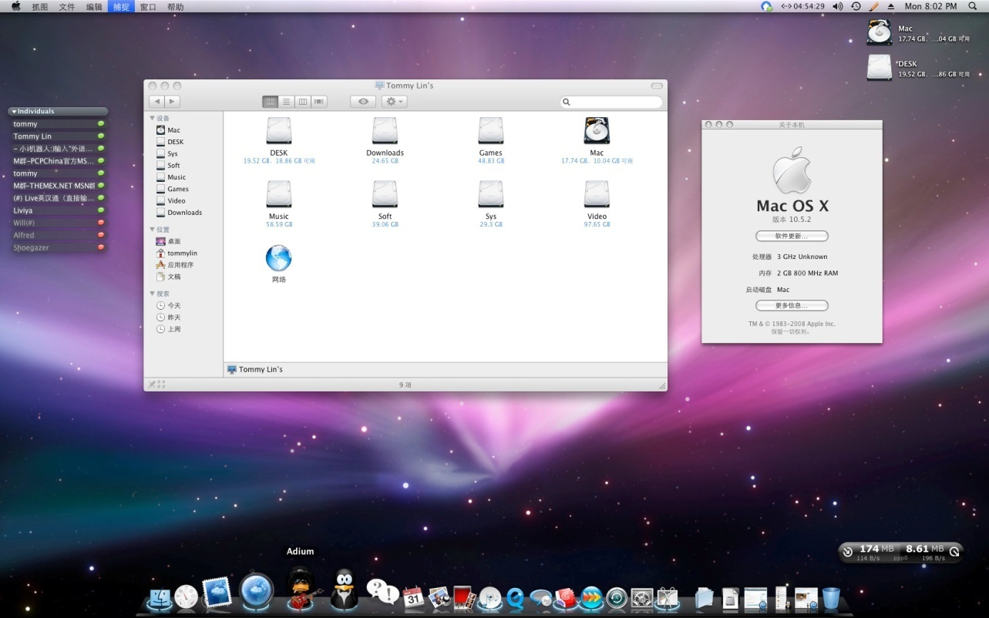
OS X – Quite Different!
More use of colors, icons.
Added the Dock.
Gelcap style buttons

Slide 10
iOS!

Slide 11
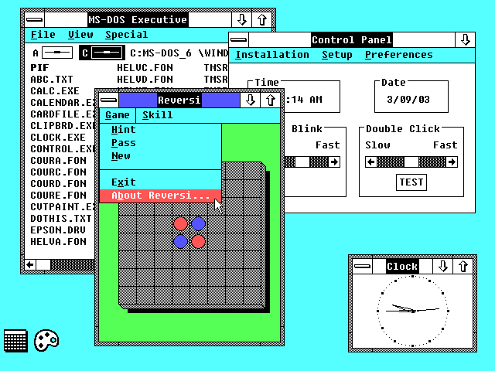
Windows 1.0 (1985)

Slide 12
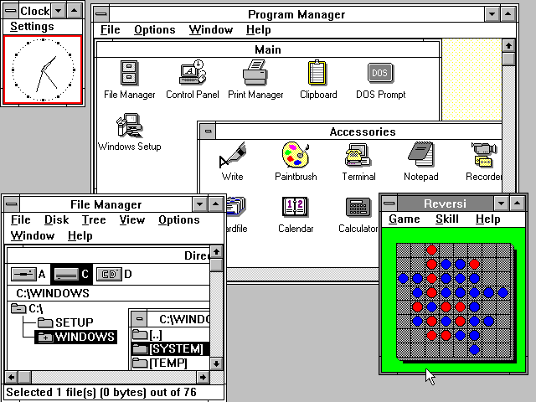
Windows 3.0 (1990)

Slide 13
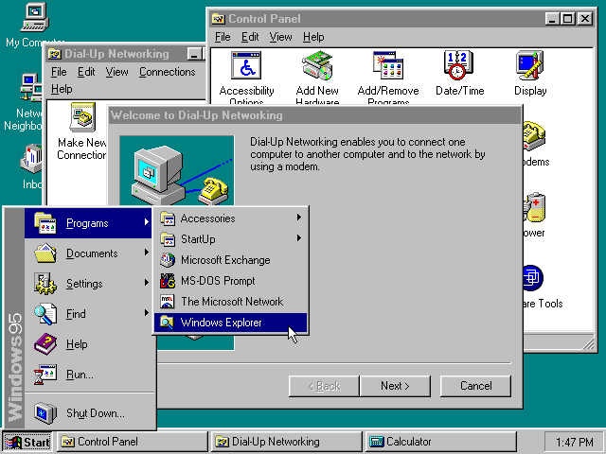
Windows 95

Slide 14
Windows 8 (2012)

Slide 15

Linux History!
Richard Stallman
Free Software Foundation
GNU

Slide 16

Linus Torvalds
Added the Kernel to GNU and thus Linux was born!

Slide 17
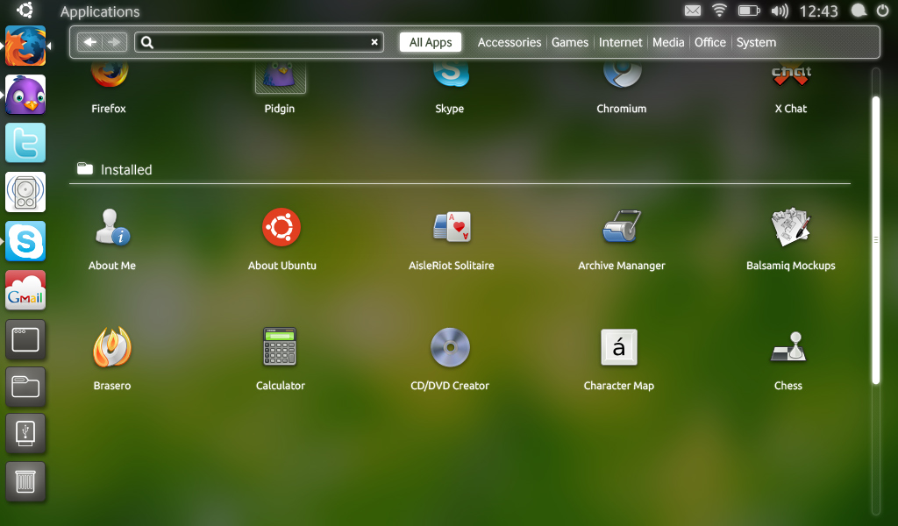
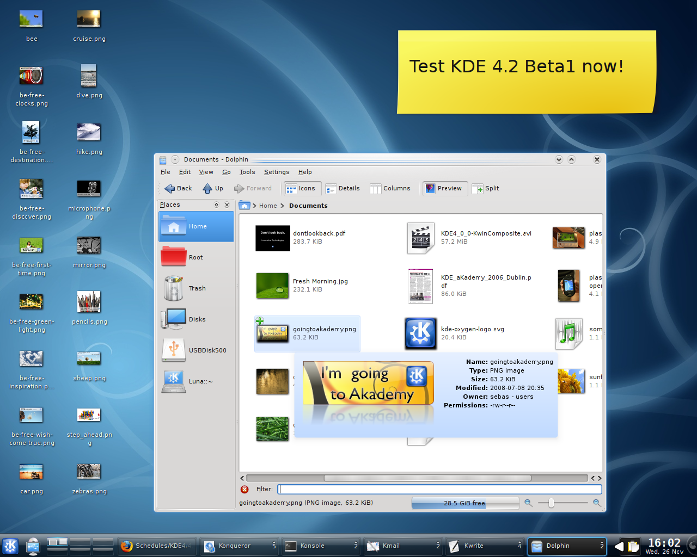
Gnome (1999 – Present) & KDE (1996 - Present)

Slide 18
Anything Seem Kind of Weird?
They ALL use the same overall paradigm
Desktop
Windows
Etc.
Except the mobile UIs which use the “app” paradigm.
Why might this be the case?

Slide 19
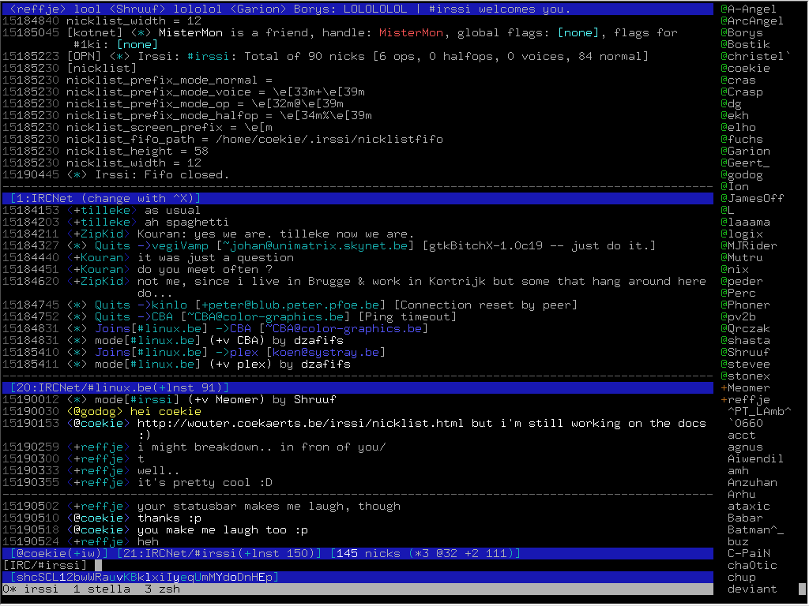
Consoles

Slide 20
Discussion
What are some of the advantages and disadvantages of desktop environments versus console environments?
What kinds of users use each respective environment?

Slide 21
Lesson 1!
Some users (power users) actually benefit from the more rudimentary design and increased control provided by the console.
Other users (my Mother) benefit from the more restricted but “noob” friendly windowed environments.
Thus, the design of an interface is HIGHLY DEPENDENT on the expected user base!
We will look at this in more detail next time.

Slide 22
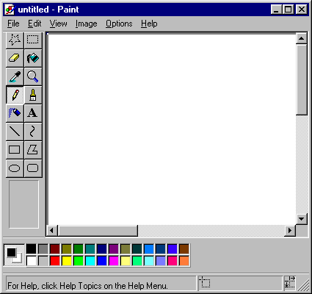
Example (Paint vs. Photoshop)
MS Paint is designed for users mostly unfamiliar with photo editing performing very simple tasks.

Slide 23
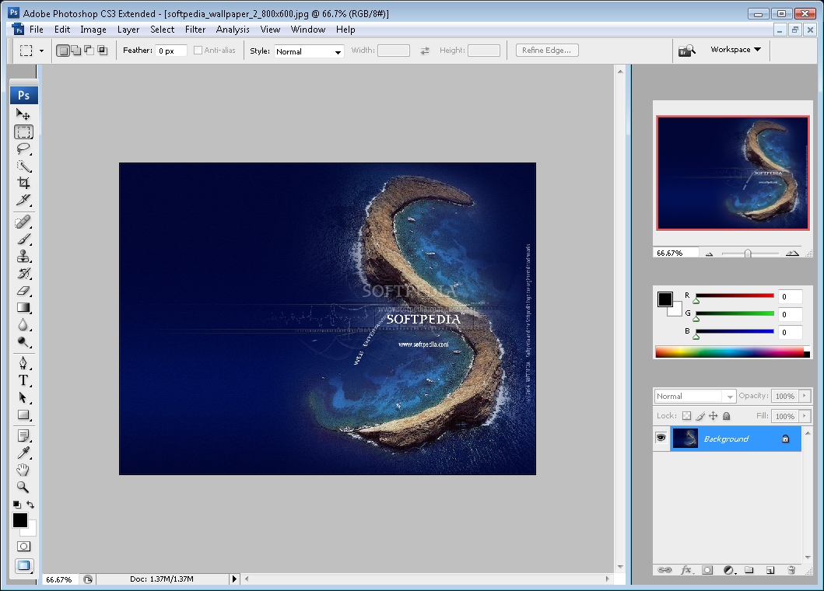
Photoshop
PS, on the other hand, is more difficult to use but more powerful. Designed for serious photo editors, artists, etc.

Slide 24
Lesson 1!
The design of an interface is HIGHLY DEPENDENT on the expected user base!

Slide 25
Why Does the Desktop Paradigm Work?
Thoughts??

Slide 26
Why Does the Desktop Paradigm Work?
Because it fits the paradigm of working on a physical desktop, which is what people used computers for.
Thus, many other tasks become intuitive, such as searching for files within folders, etc.

Slide 27
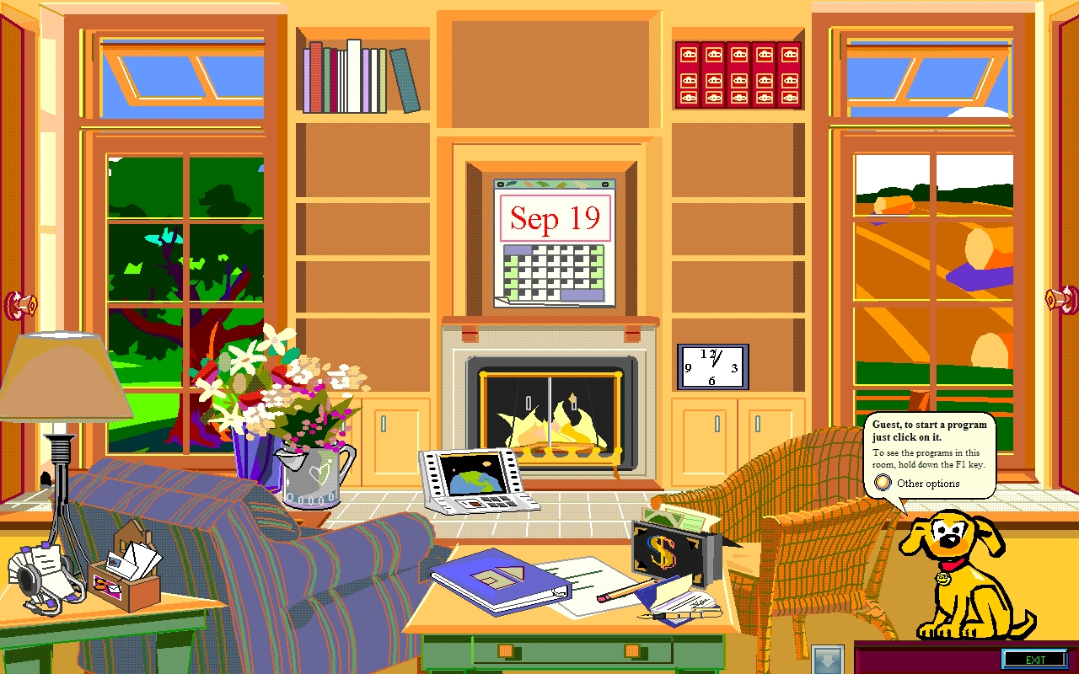
Moving on…Windows BOB (~1995)
Just…why?

Slide 28
Why Does the Desktop Paradigm Work?
Windows BOB flopped
But why?
Why did the desktop paradigm that we use now prevail?

Slide 29
Lesson 2!
The desktop paradigm is an example of a CONCEPTUAL MODEL, and we will talk about these in more detail later.
Framing a conceptual model that fits your users is VERY important for HCI.
Windows BOB was an example of an overfit metaphor.
Desktop paradigm is quite good…right level of abstraction.

Slide 30
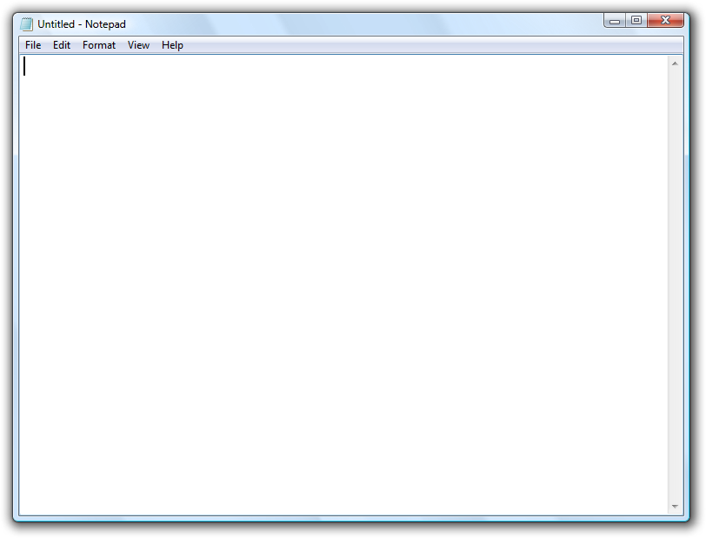
Another Example (Notepad vs. Word)
Notepad for Windows is designed to be an extremely simple text editor.
Not for users writing 200 page theses. Conceptual model is that of a piece of paper you pick up to scratch notes on.

Slide 31
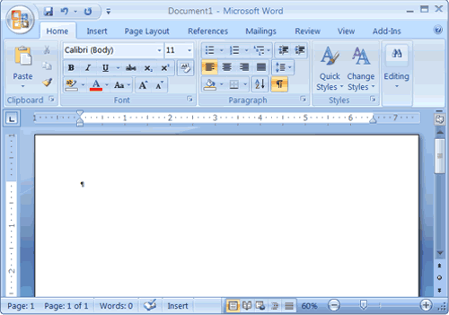
Cont.
Word, on the other hand, is tightly coupled to the document writing model.
Documents, pages, headers, bibliography features, etc.

Slide 32
Lesson 3!
Interfaces are also highly dependent on the tasks the user wishes to complete (or perhaps the task the designer WANTS the user to complete).

Slide 33
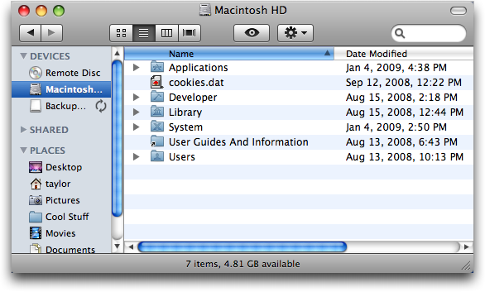
Lesson 3 Example
The Windows (or Mac) file viewer has the explicit task of helping you visualize the file structure on your system. The interface reflects this goal:

Slide 34
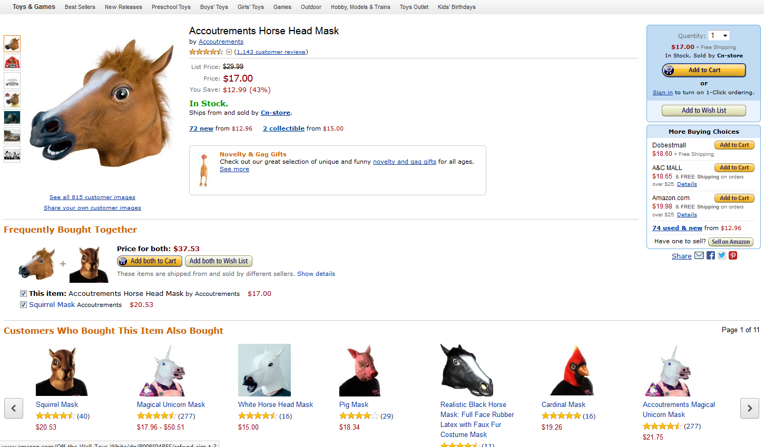
Lesson 3 cont.
In contrast, Amazon.com is designed for the task of users buying things (whether they want to or not).

Slide 35
Review of Lessons Today
Lesson 1: Interface Design is highly dependent on the user base that will use the software.
Lesson 2: Interface Design often incorporates conceptual models to ease the cognitive load of users by introducing familiar paradigms.
Lesson 3: The tasks that users wish to complete is an important consideration when designing a UI.

Slide 36
Summary!
Good interfaces are designed with three essential things in mind:
The USERS that will be using the system.
The TASKS those users must achieve.
A CONCEPTUAL MODEL of expectations for the interaction.
In the next few lectures, we will look at each of these in detail.

Slide 37
Questions!

